Slide 1

GROUP 13
Samarjeet Chavan
Taranjot Dang
Anirudha Joshi
Preeti Kulkarni
Dandan Zhu

Slide 2
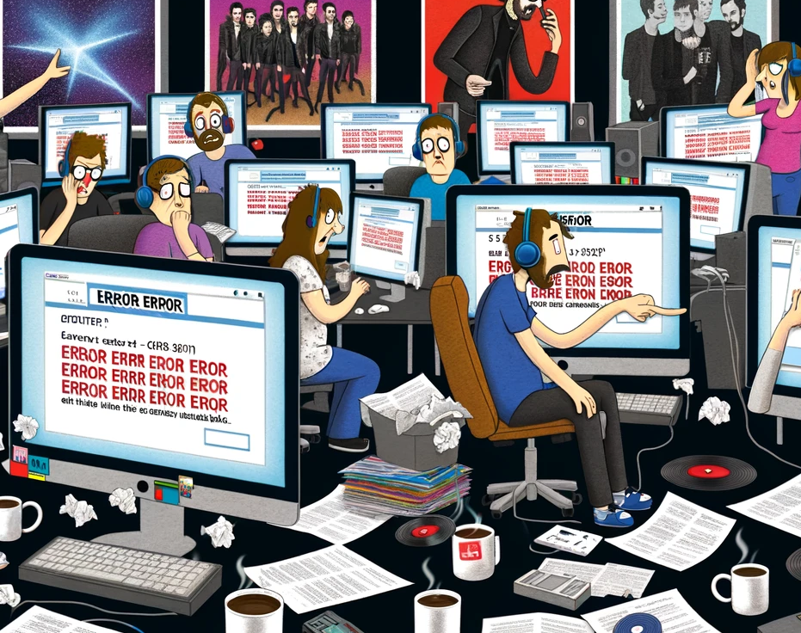
PROBLEM STATEMENT:
In the fast-paced music industry, stakeholders like record labels, artists, and marketers struggle to grasp trends and predict consumer behavior due to a lack of comprehensive tools that consolidate music-related data. This shortfall impedes strategic planning and market analysis, restricting adaptability to evolving listener preferences and industry dynamics.

Slide 3

OBJECTIVES:
User Behavior Analysis
Content Analytics
Scalability and Performance
Feedback and Review System
Data Security and Privacy Compliance

Slide 4

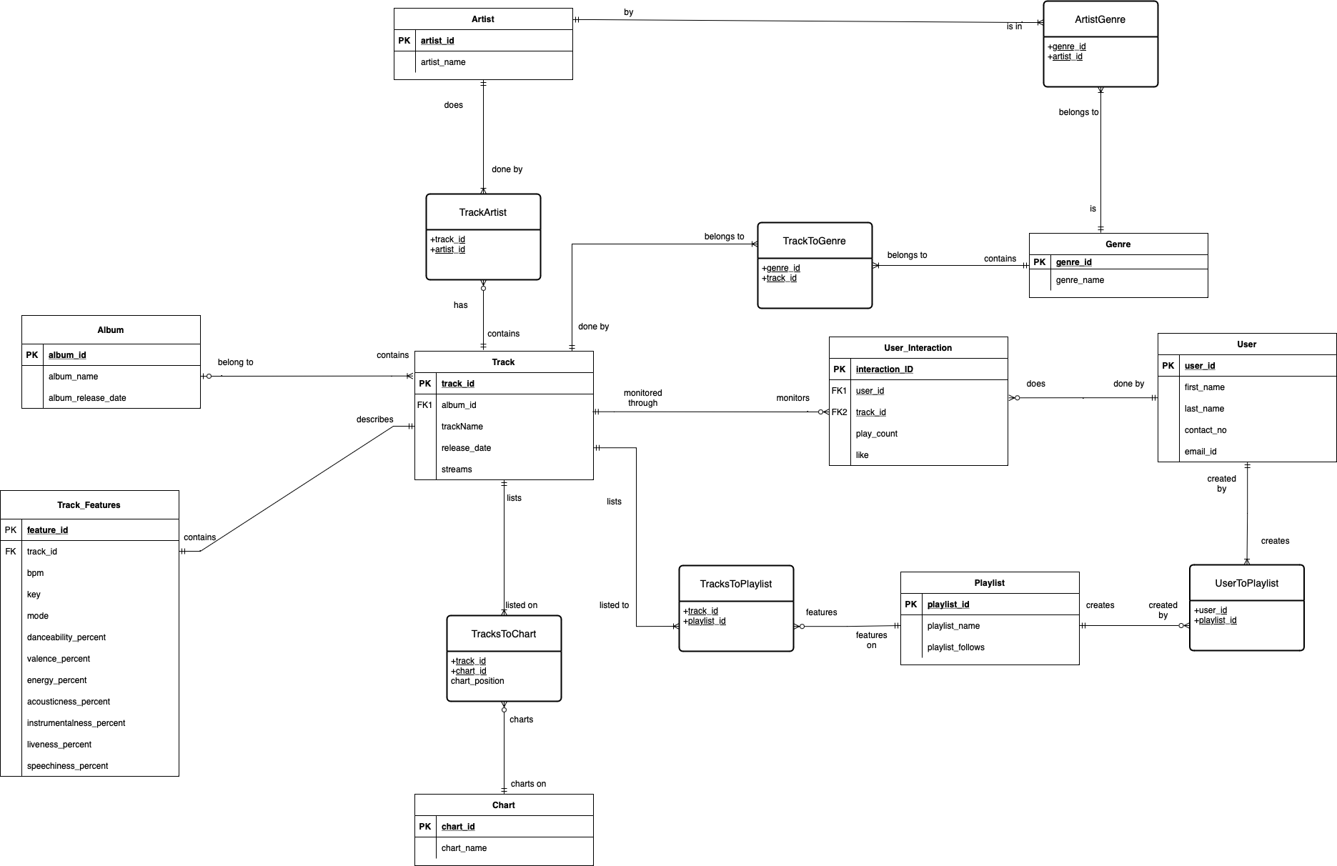
ENTITY-RELATIONSHIP DIAGRAM

Slide 5

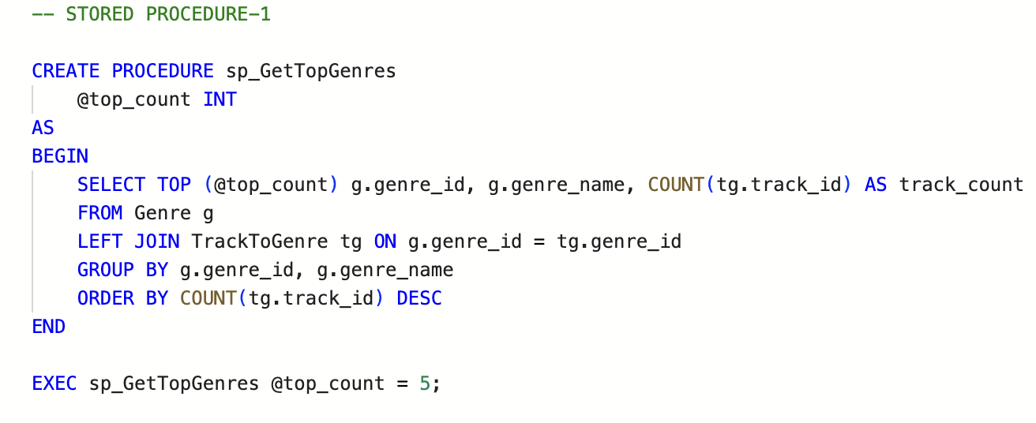
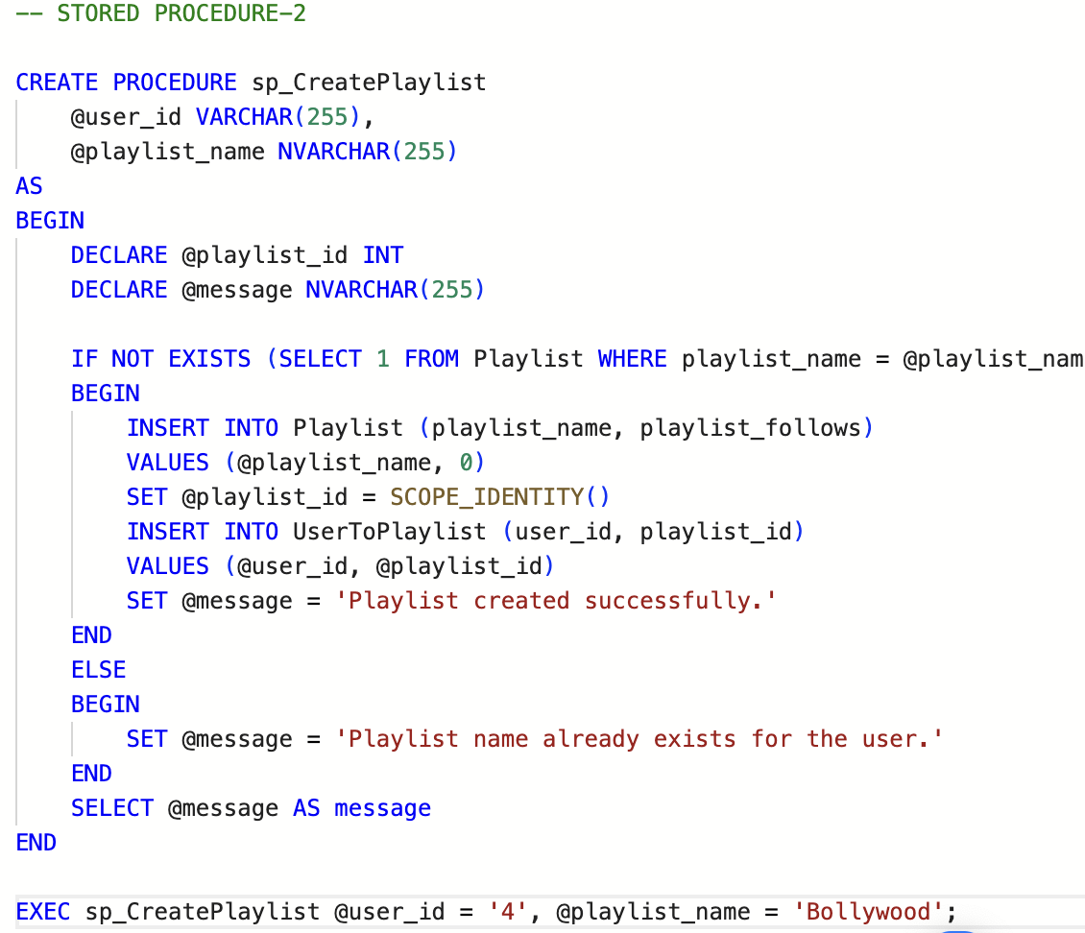
STORED PROCEDURES

Slide 6
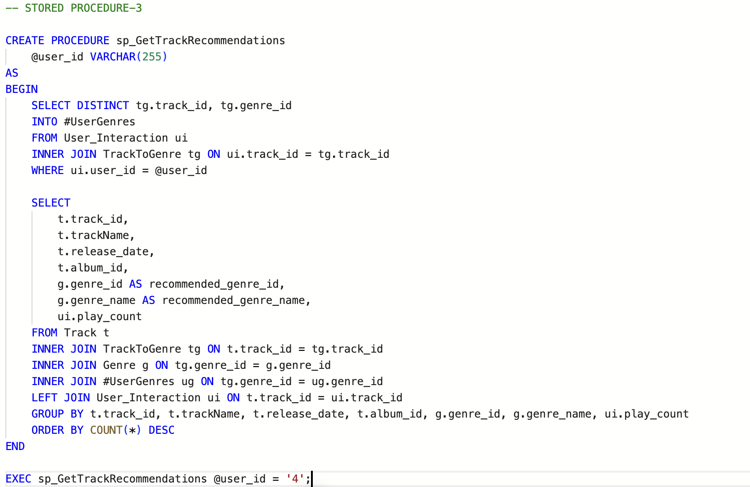
STORED PROCEDURES

Slide 7

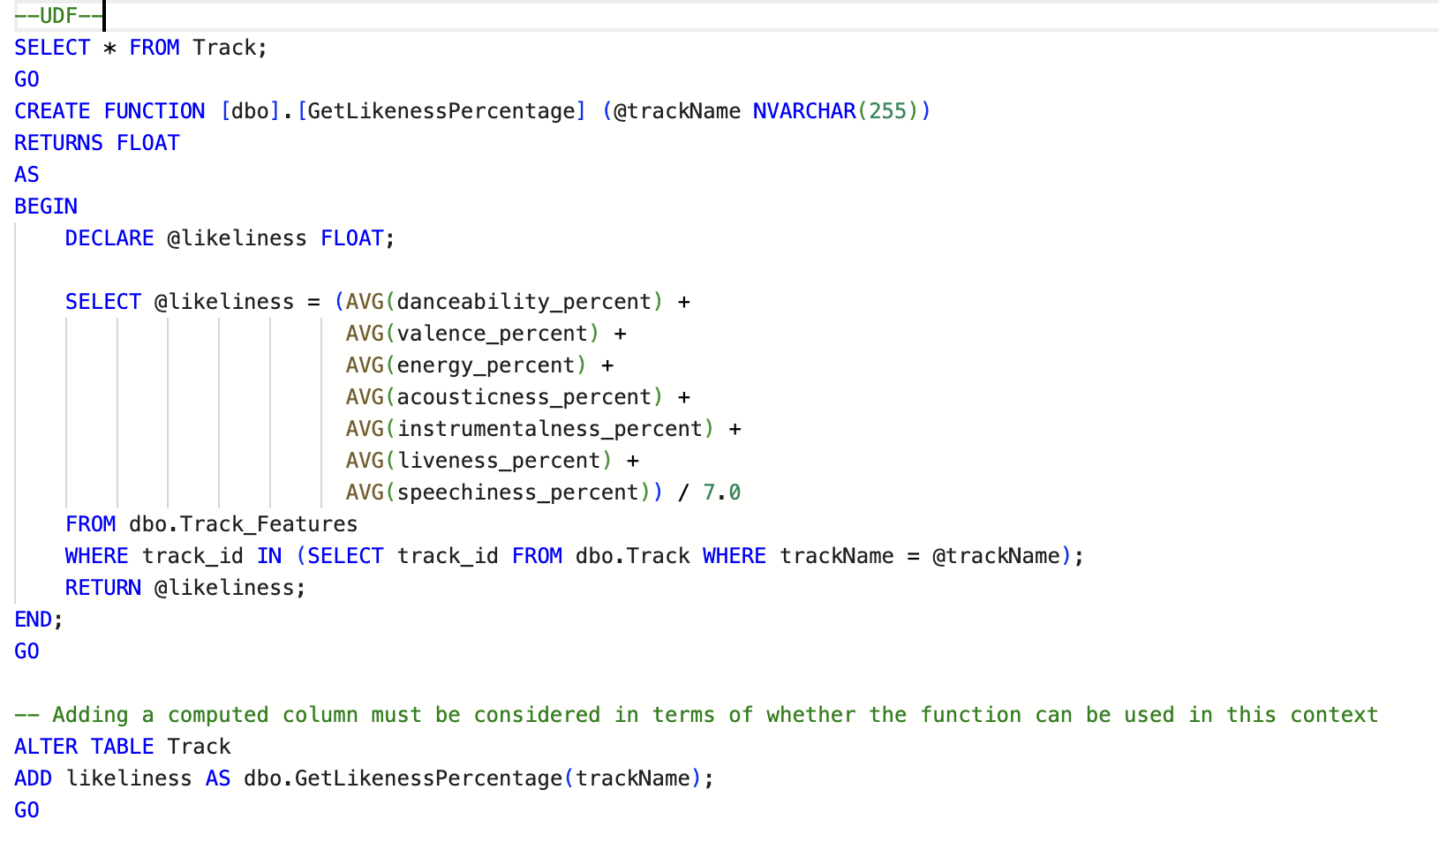
User Defined Functions

Slide 8

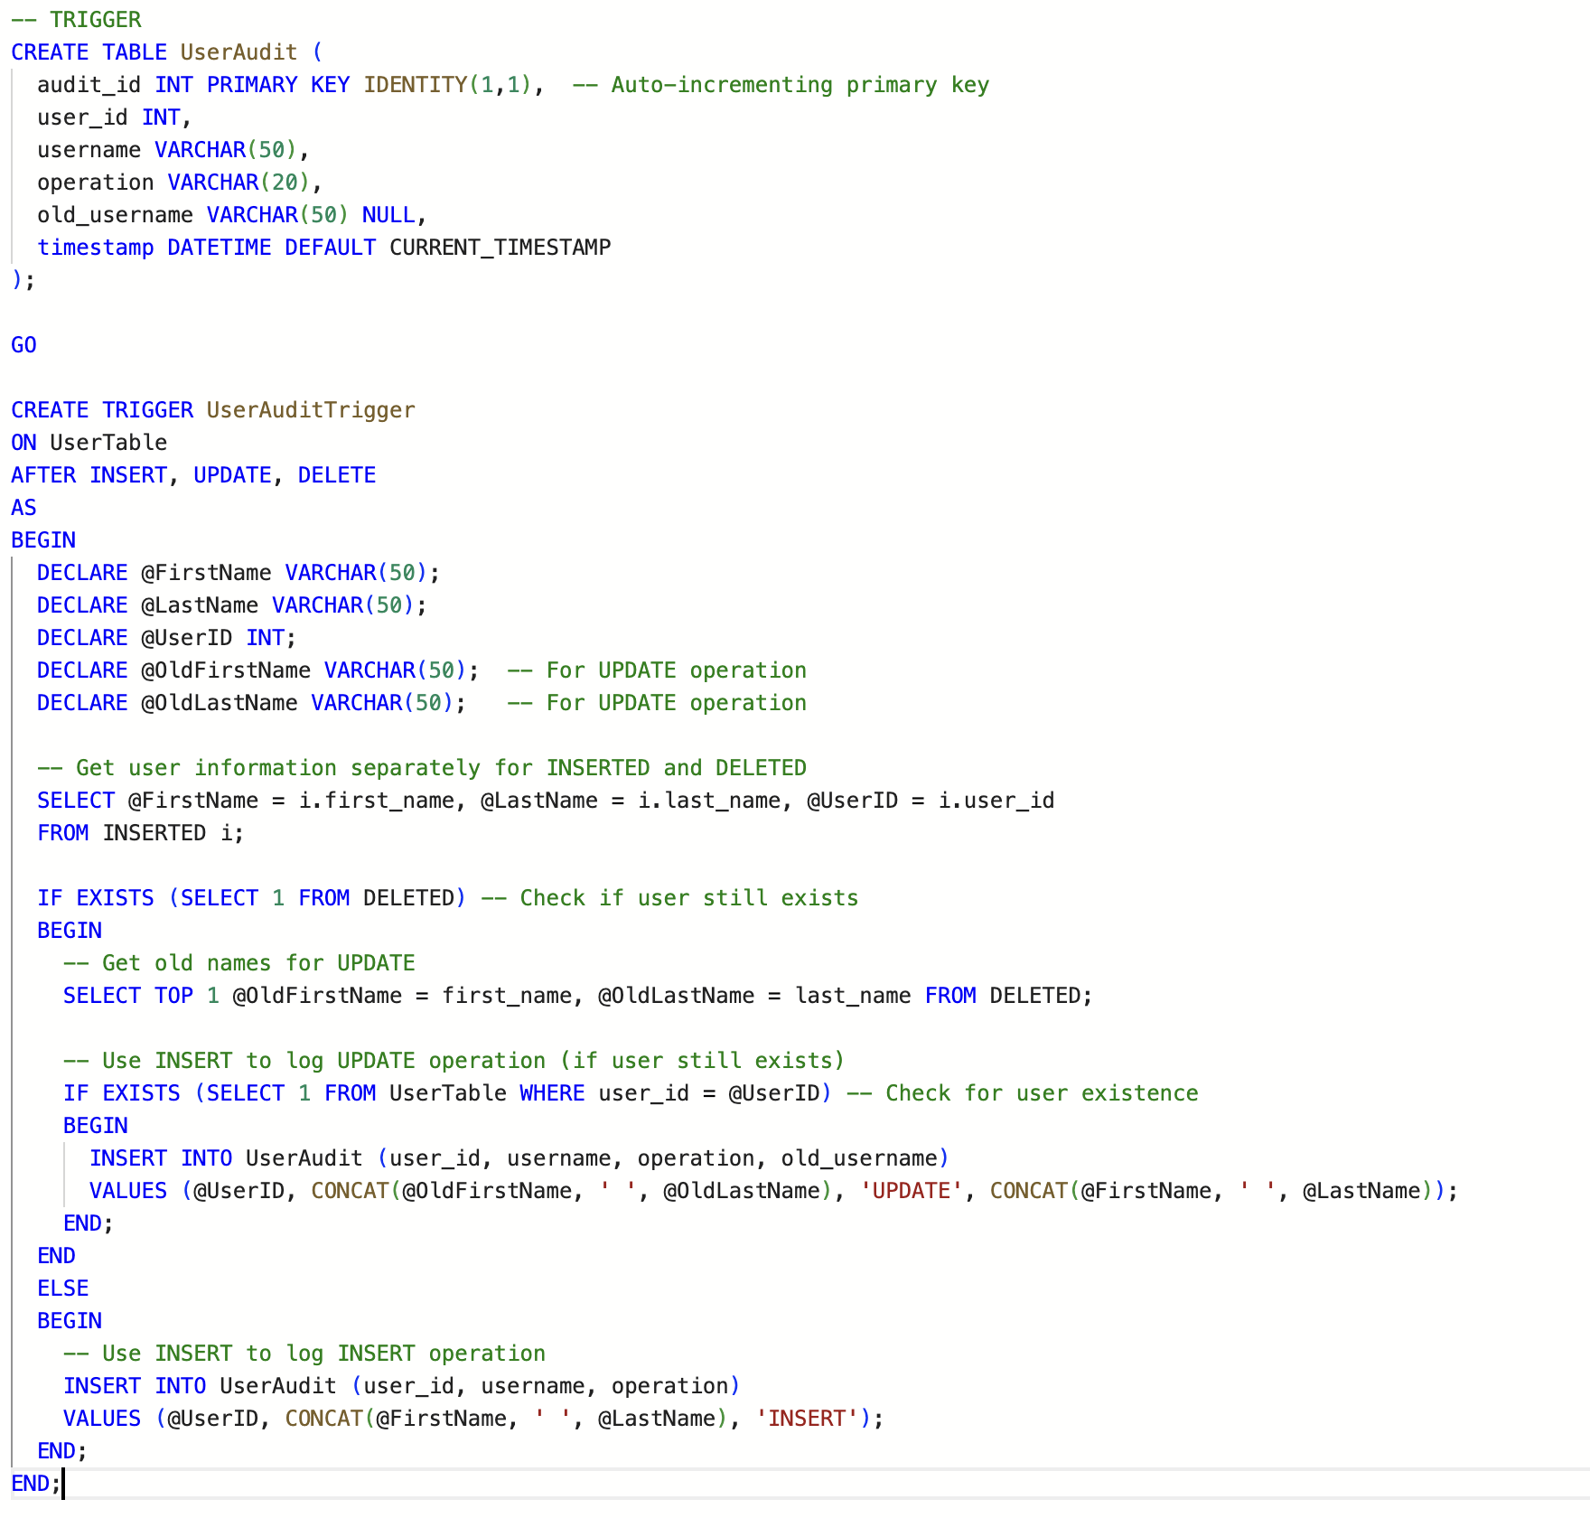
Triggers

Slide 9

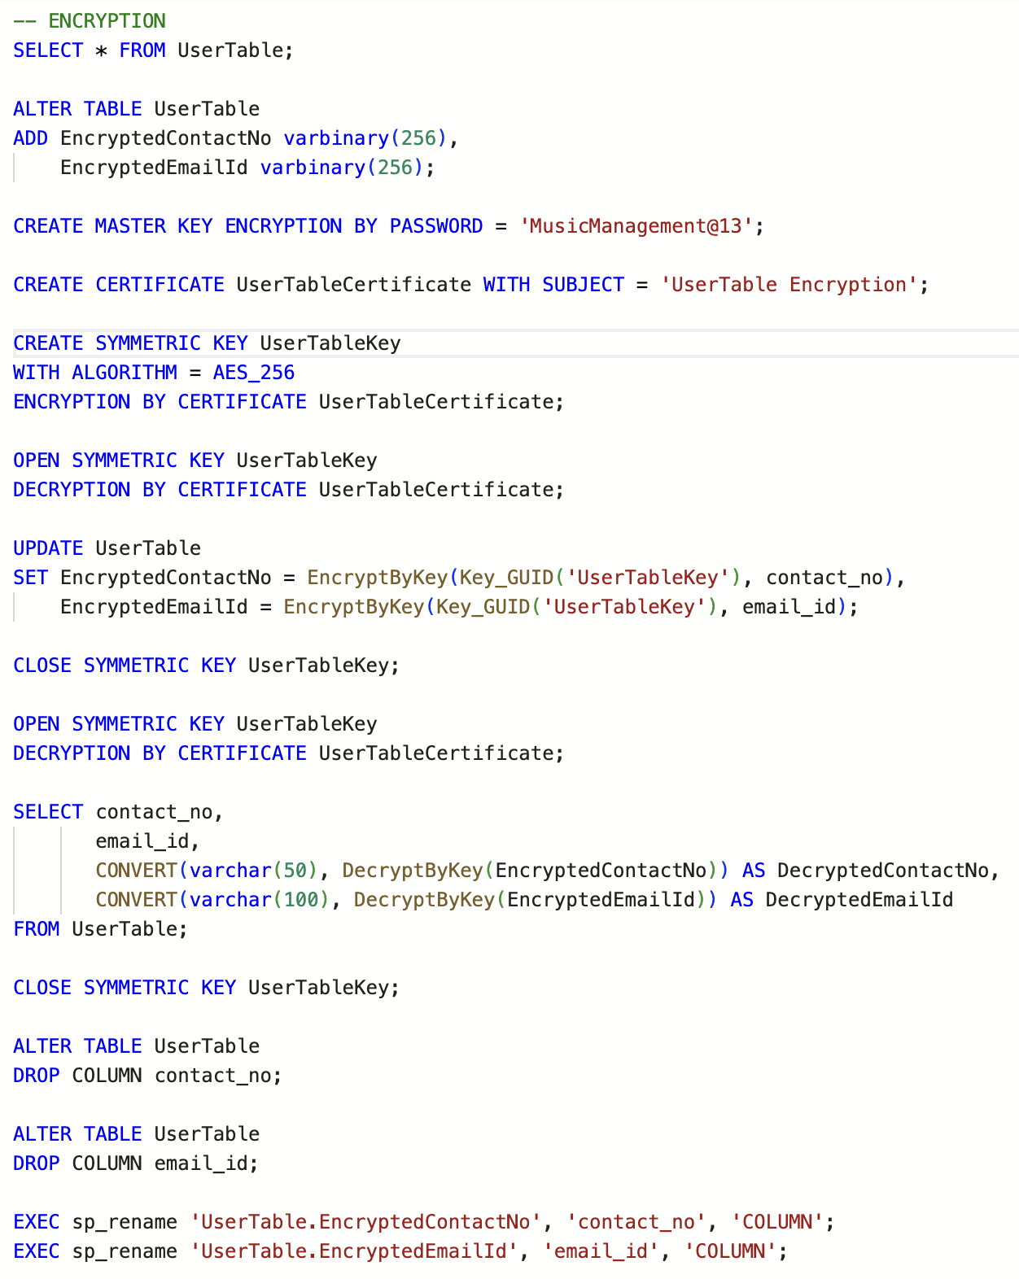
Encryption

Slide 10
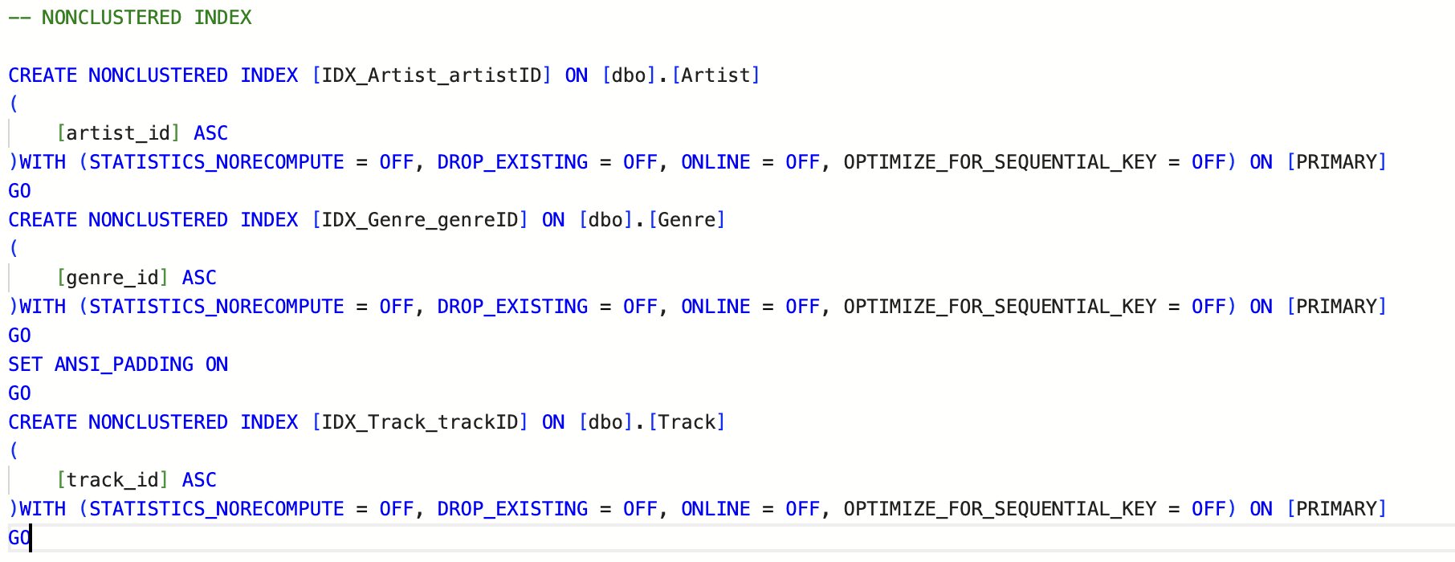
Non-Clustered Index

Slide 11
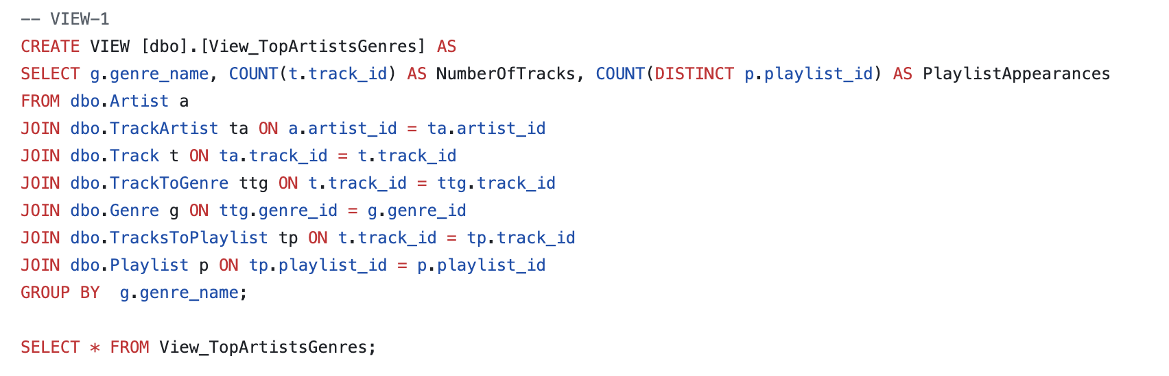
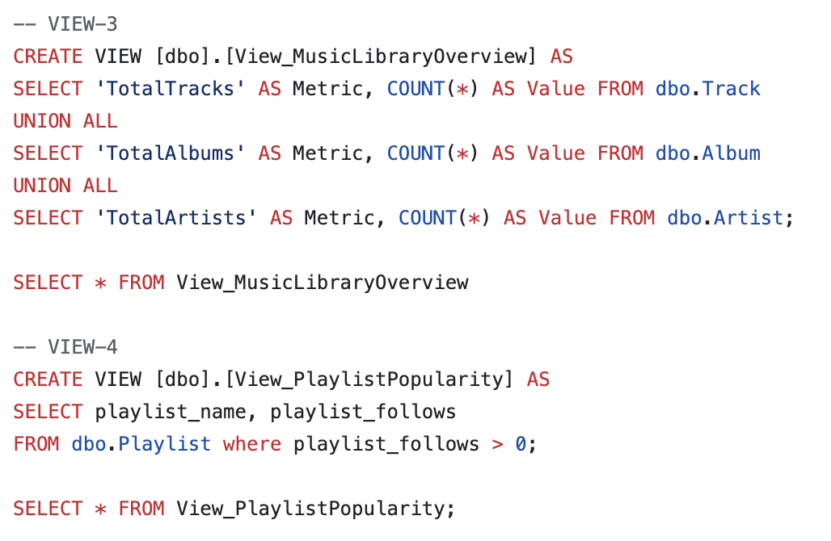
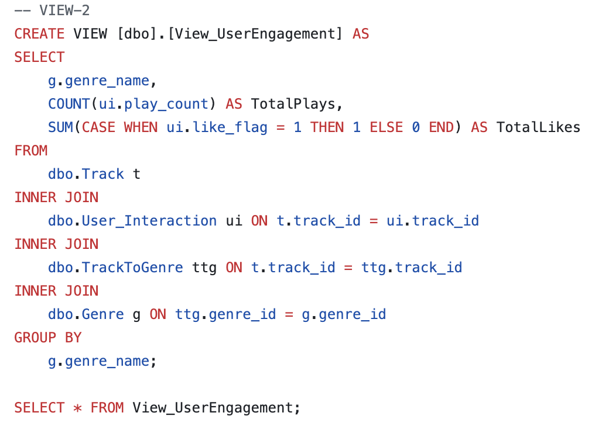
Views

Slide 12
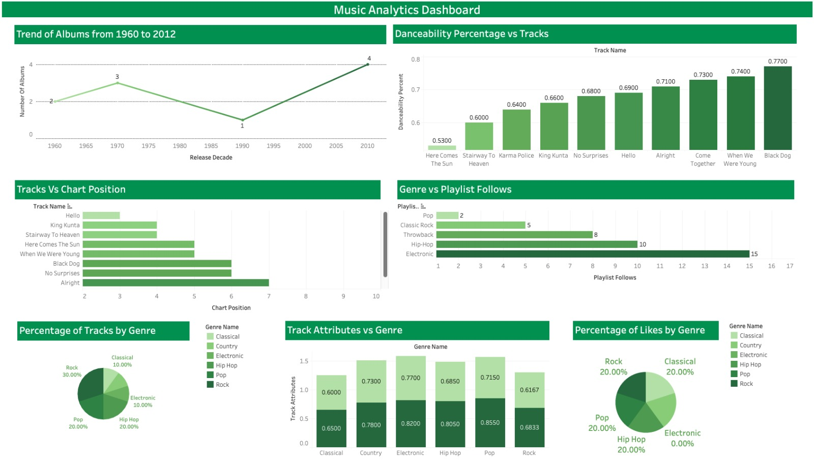

Slide 13
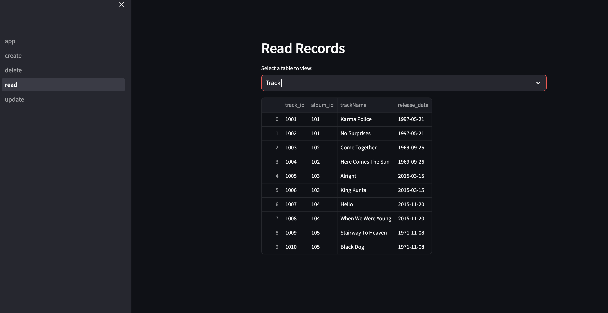
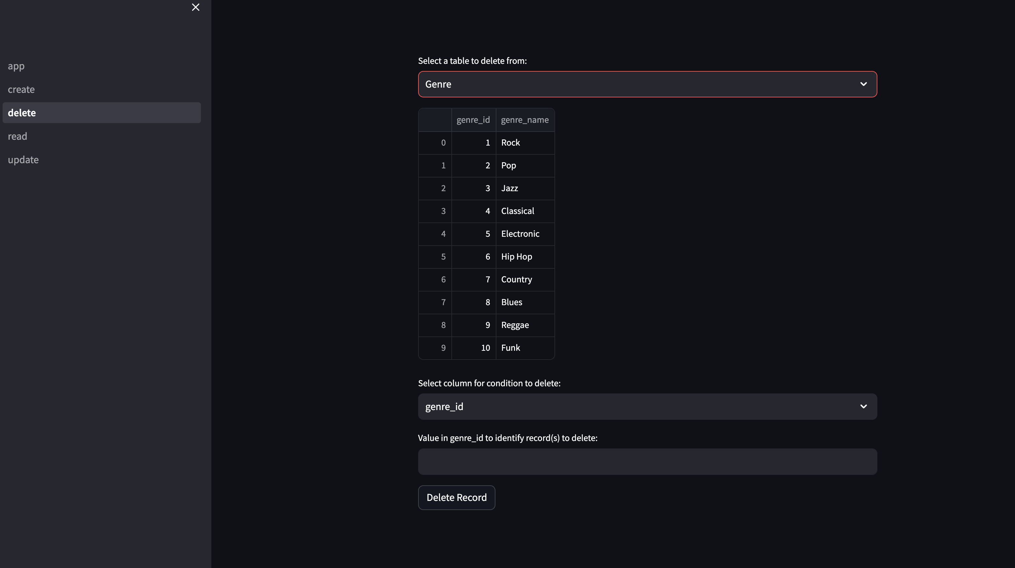
UI ON STREAMLIT

Slide 14
DEMO DEMO VIDEO

Slide 15
Questions?

